Slide 1
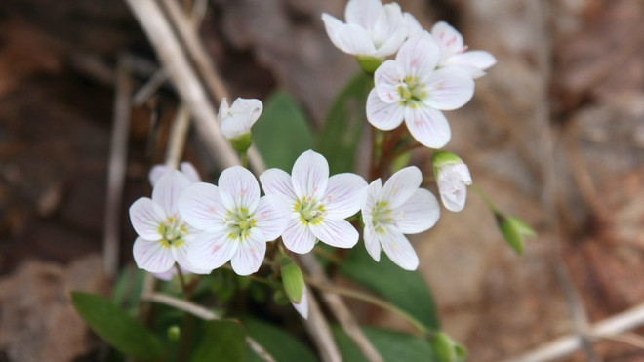
“Eternally Green”
An Introduction to Green or Natural Burials
Presented by Green/Natural Burial Advocate:
Mark Richardson

Slide 2
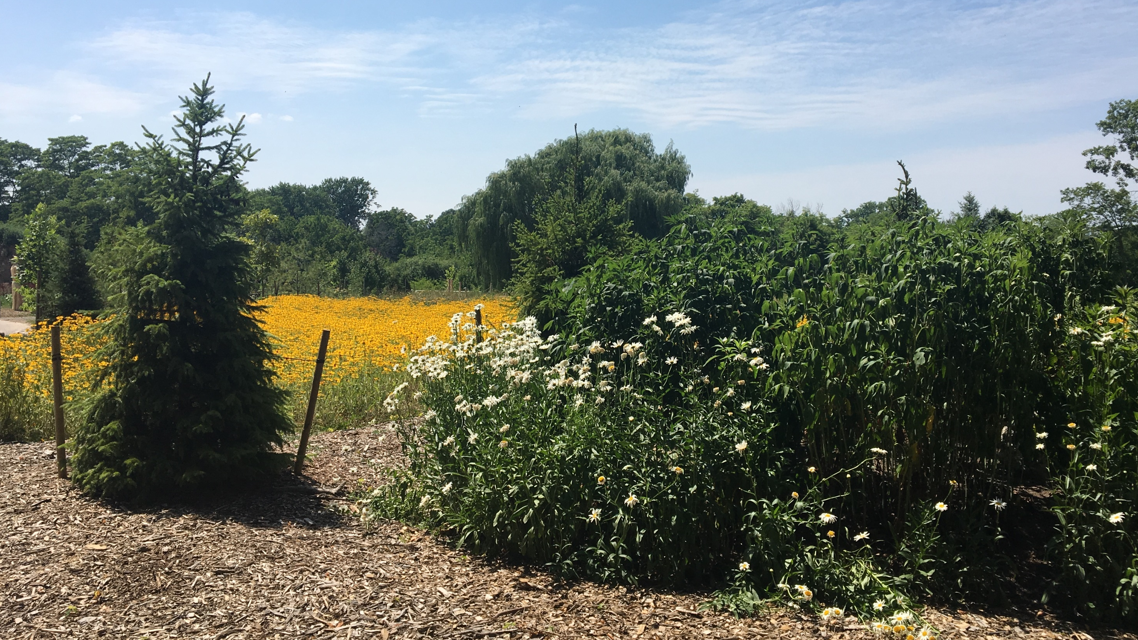
Introductions
Mark Richardson, Manager of Cemetery Services, City of Niagara Falls
Member of the Board of Directors of the Green Burial Society of Canada, the Natural Burial Association in Ontario and was recently elected to the Board of the Ontario Association of Cemetery and Funeral Professionals.

Slide 3
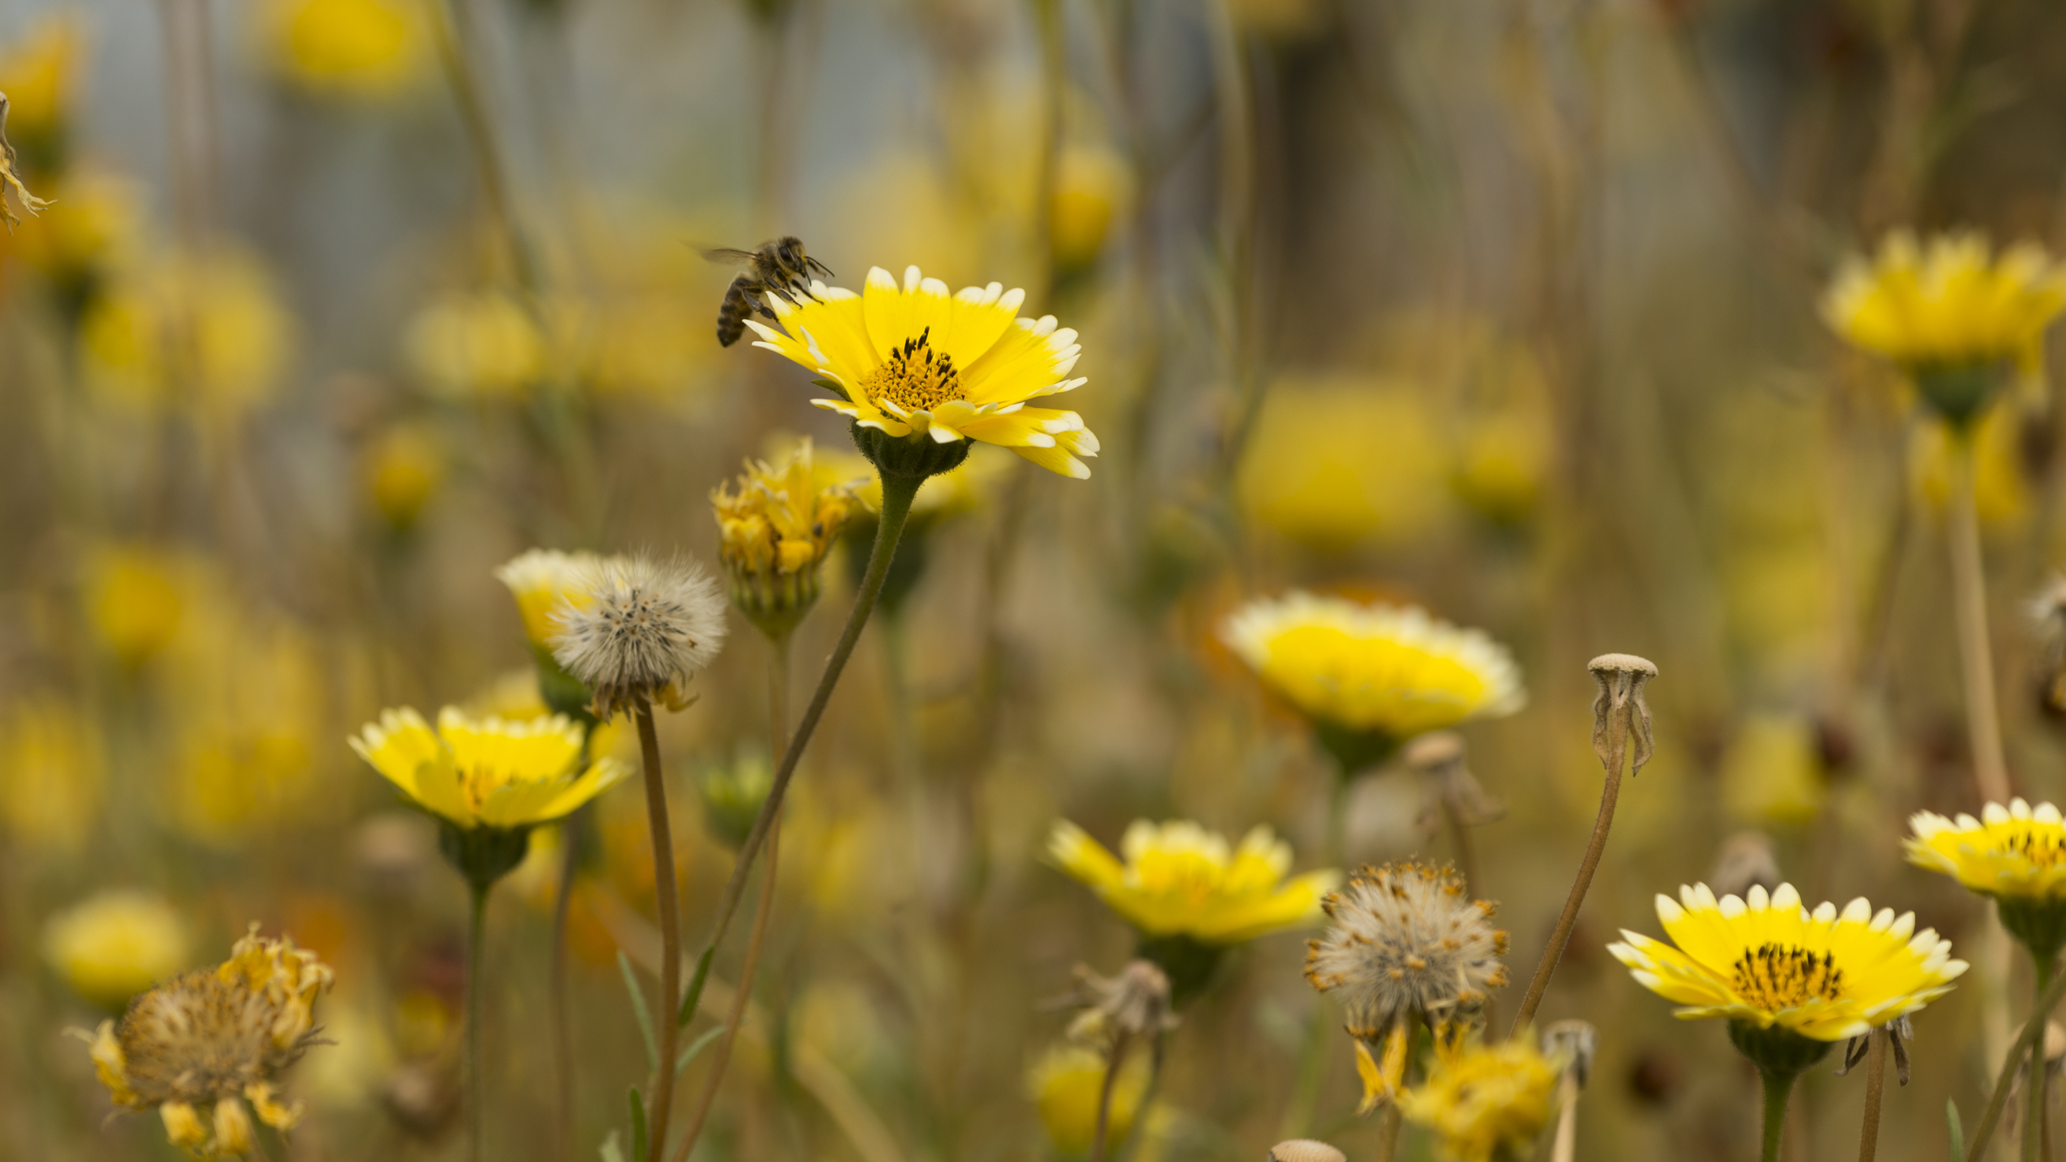
Defining Green or Natural Burial
A natural burial is the act of returning a body as naturally as possible to the earth. Natural burials offer a simple connection between life and death, and an alternative to today’s industrial options.

Slide 4
The Five Principles of Green Burial

Slide 5
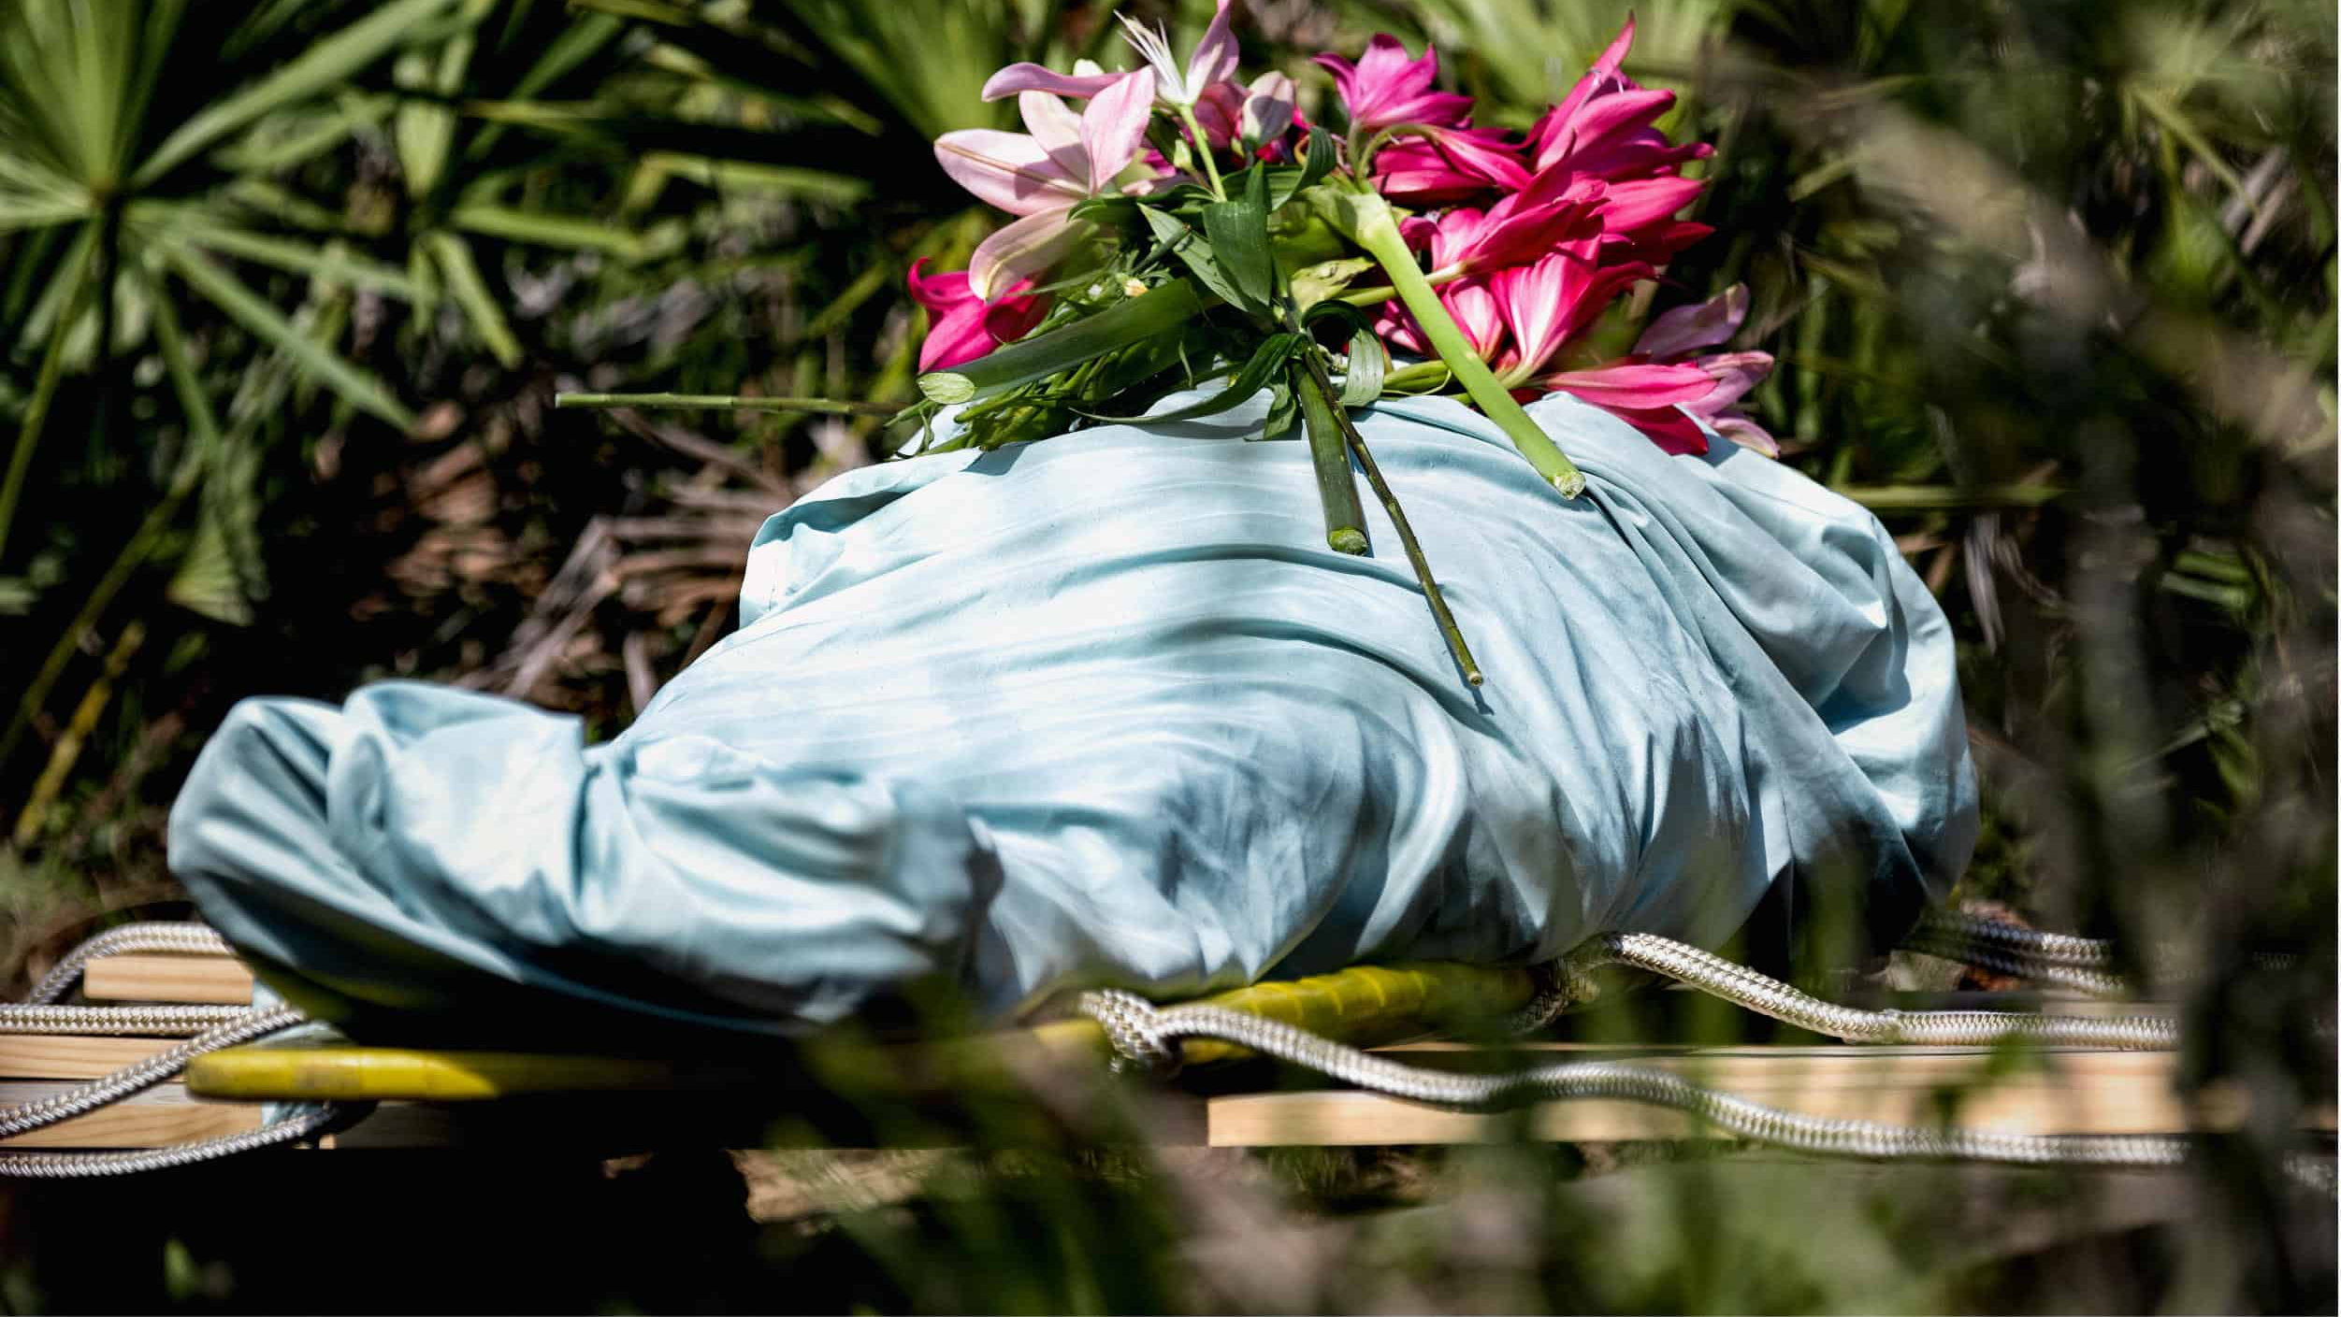
#1 No Embalming
Decomposition is nature’s way of recycling a body.

Slide 6
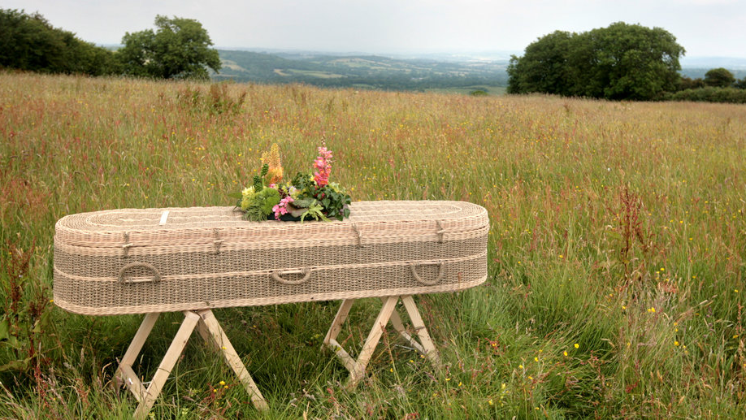
#2 Direct Earth Burial
For green and natural burial, no outside grave liner or protective vault is used. The shrouded and/or casketed body is buried directly into the ground.

Slide 7
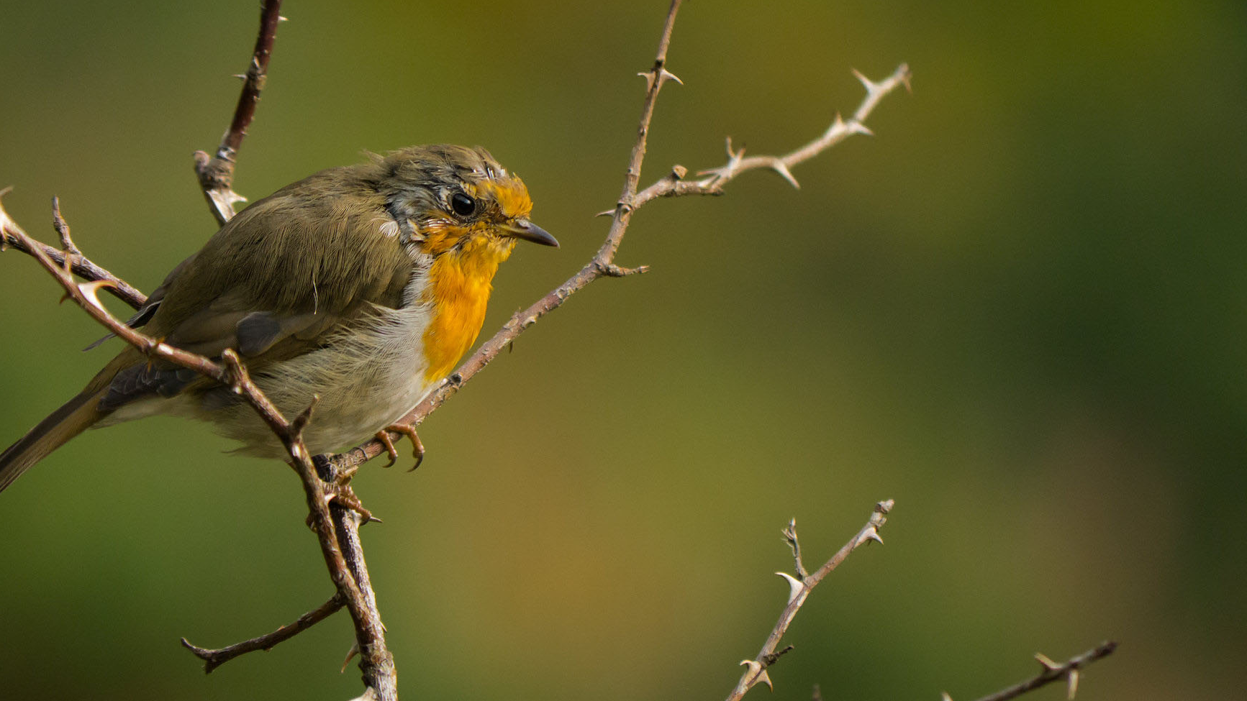
#3 Ecological Restoration & Conservation
Site preservation and perpetual protection is a key component of this principle of green and natural burial.

Slide 8
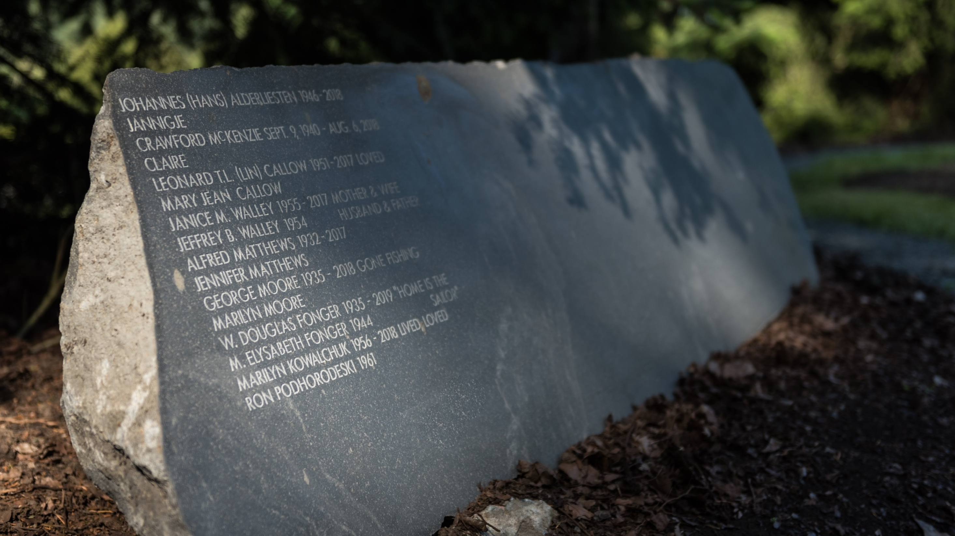
#4 Communal Memorialization
Ultimately it is the green or natural burial site as a whole that becomes a living memorial to the persons interred there.

Slide 9
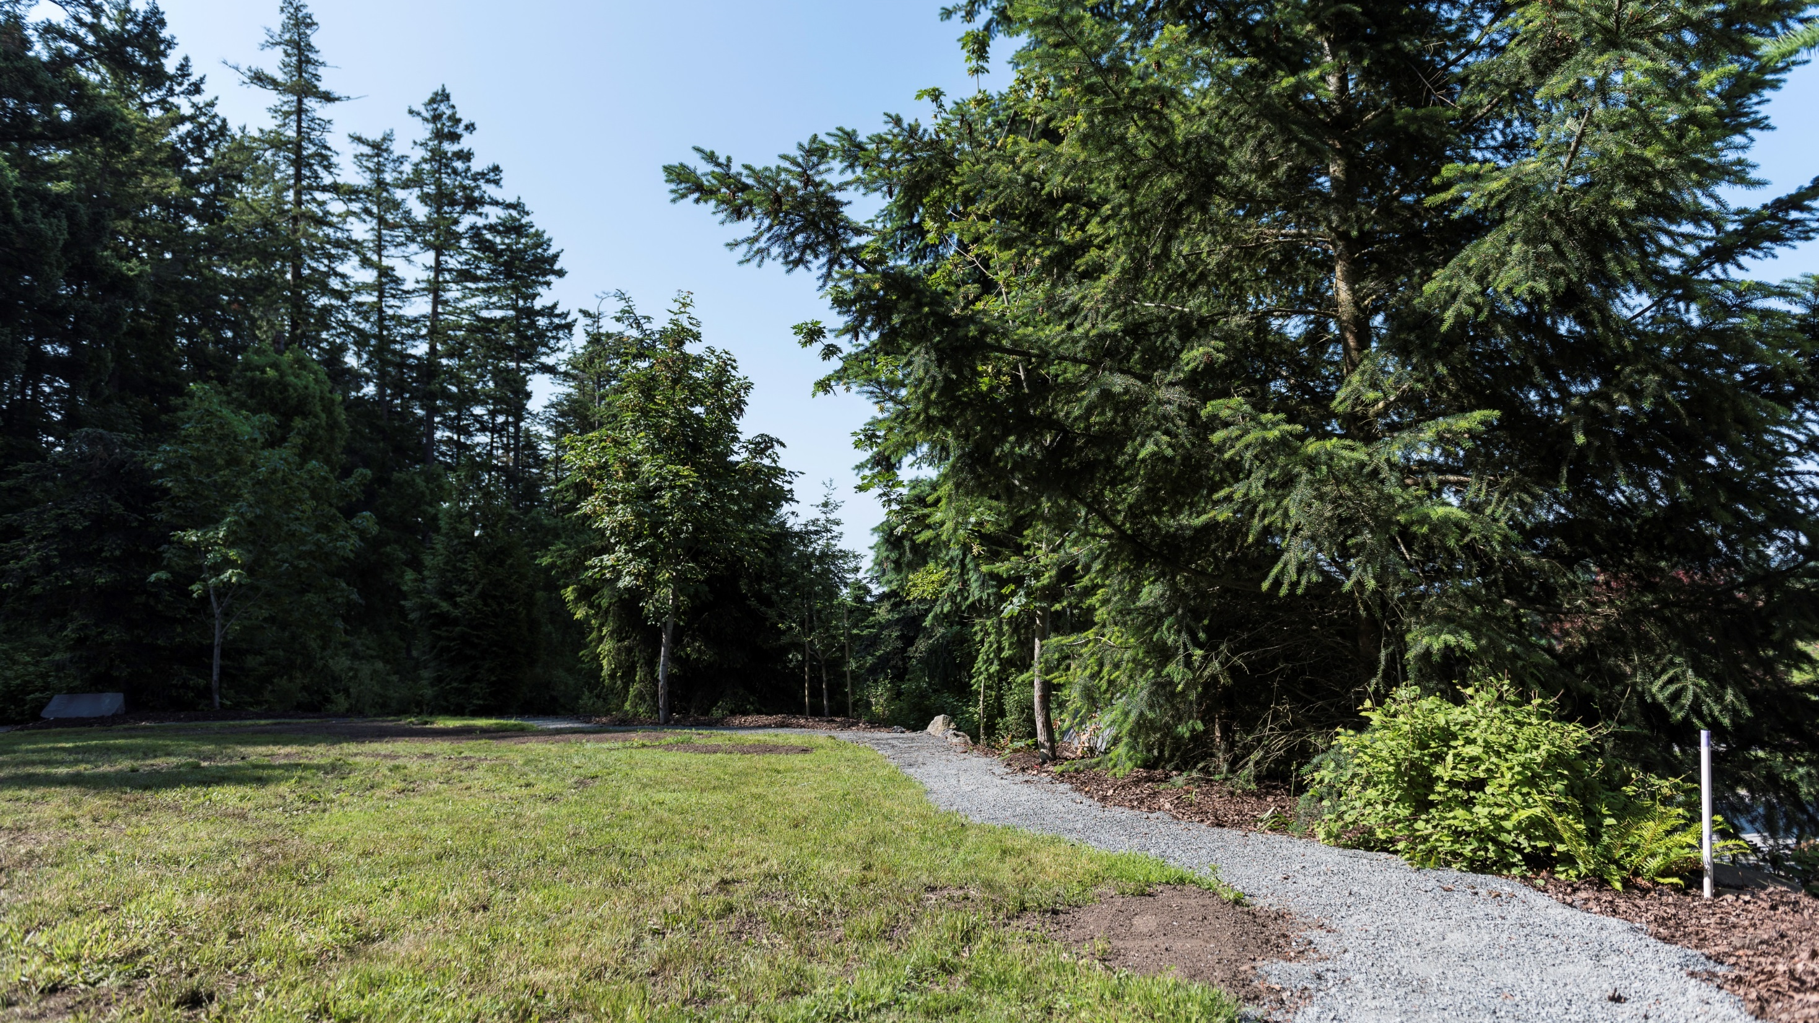
#5 Optimize Land Use
A well-planned green or natural burial cemetery (or cemetery section) will optimize the land it occupies.

Slide 10
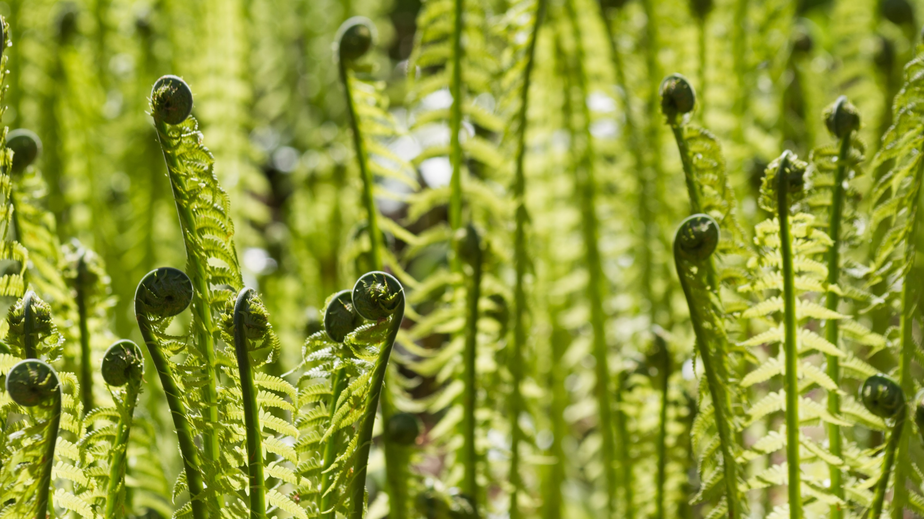
Why Green or
Natural Burial?

Slide 11
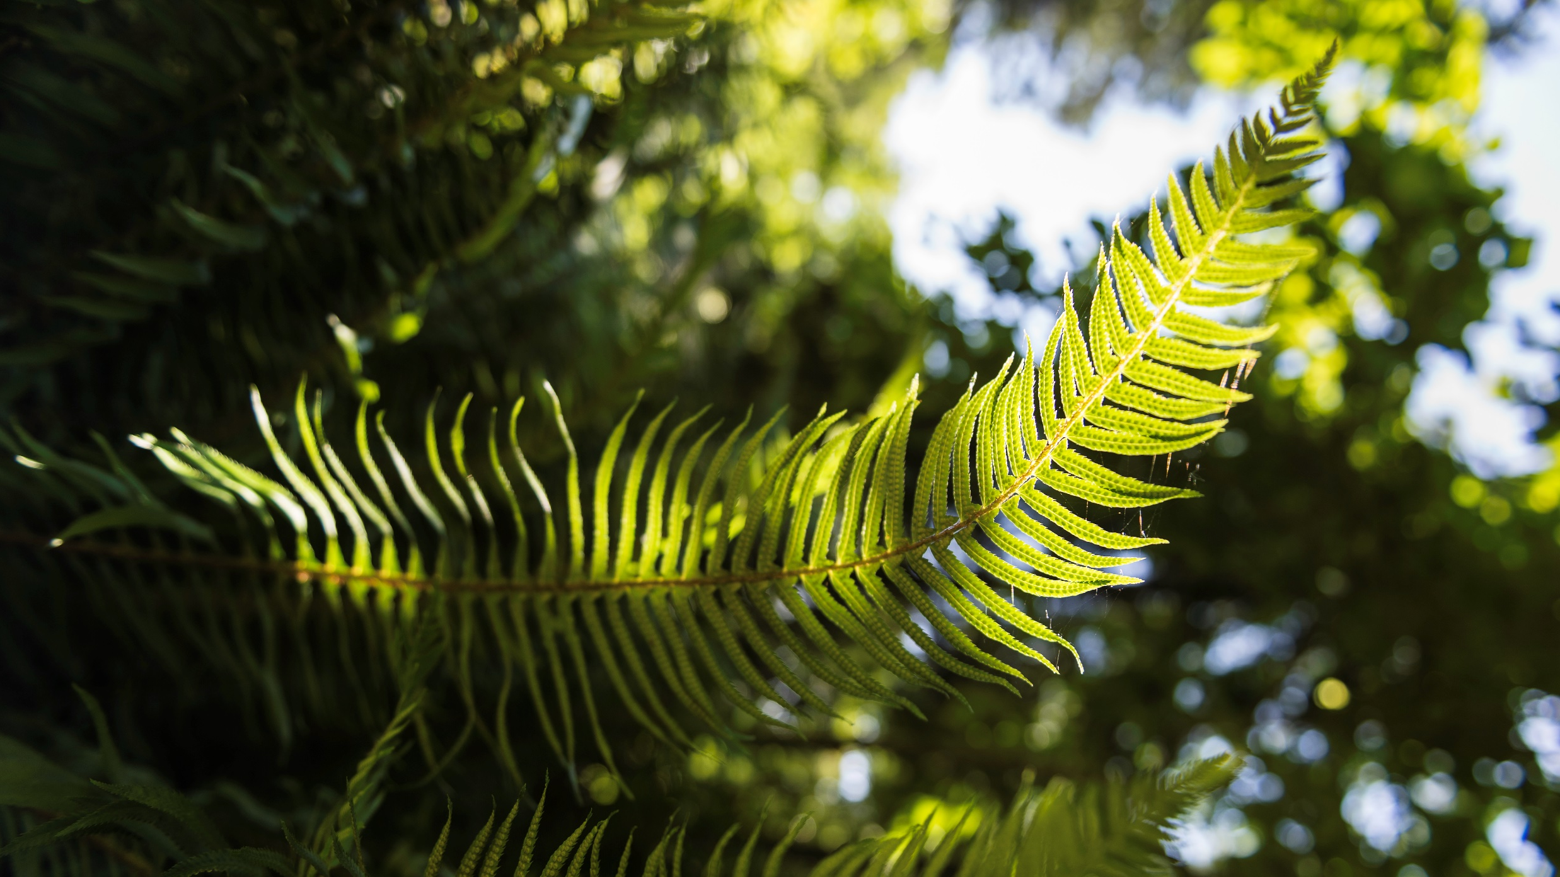
Why a Natural Burial?
Reduced environmental impacts
Potential for enhanced family engagement
More efficient land use
Enhanced habitat and natural green spaces
Reduced maintenance costs
Enhance and enrich the community socially and environmentally

Slide 12
Misconception of Green/Natural Burials

Slide 13
A new idea… “just a fad!”
Green/natural burial is how humans have traditionally buried their dead;
Examples of dignified interment of humans as far back as 10,000 BCE and Neandrathals 62,000 BCE;
Judaic and Islamic burial has always been green; and
More of a return to simpler practices in reaction to the “modern” and elaborate funeral practices such as embalming, sealing caskets and vaults, etc.
A 2015 Nationwide Harris Poll: interest increased from 43% to 64% between 2010 and 2015

Slide 14
A low cost budget driven choice…
Can it be more cost effective? Yes;
But, for families who have chosen green burial, cost is a secondary consideration to their ability to hold a service that reflects their core values and beliefs;
A choice for green burial need not be viewed as an all-or-nothing proposition; and
Plots are often the same cost, and in a few cases, more than the cost of a traditional flat marker grave.
A 2017 NFDA Survey: 53.8% interested in green burial options (36.4% for environmental reasons, 12.4% for cost).

Slide 15
Financial Implications of Green Burial
The Green Burial Customer
Is likely one who previously had chosen cremation
Is more engaged, often prefers involvement in closing the grave
Since creating The Woodlands at Royal Oak Burial Park
At needs sales: 201
Pre need sales: 150
Grounds staff reluctant in the beginning, now it is the
highlight of their week
15

Slide 16
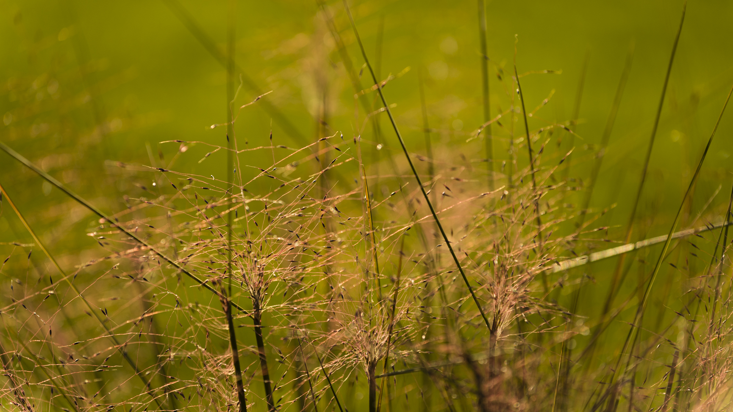
Cemetery Costs Associated with Green Burial Sites
Short term maintenance is commensurate with traditional costs
Establishing native plant regimes takes time and effort in the beginning.
Capital costs for tree, shrub cover may be more than traditional cemetery development.
Long term maintenance costs should decrease
Due to less grass cutting and “fine” maintenance
Roughly 60% of maintenance required by traditional cemetery lots
Opening and closing costs are similar to traditional burial
Machinery is still used to open and close the graves in most cases
Green burial families are much more involved – expect requests to assist with filling the grave
16

Slide 17
Care Fund Contributions
Contributions from green burial are identical to traditional graves
Remember that we always have to follow the FBCSA and associated regulations.
Due to the lower long term maintenance of green burial areas, Care Funds should benefit as more cemeteries adopt green practices.
17

Slide 18
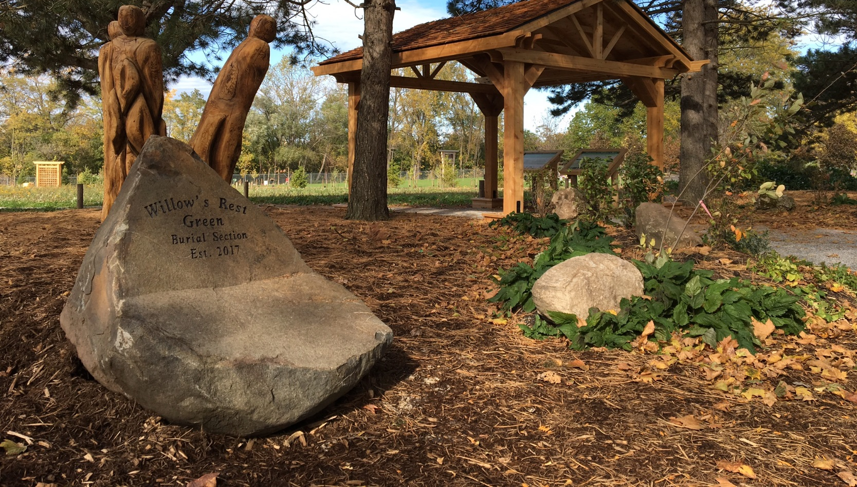
Willow’s Rest Green Burial Section
Fairview Cemetery, Niagara Falls, Ontario

Slide 21
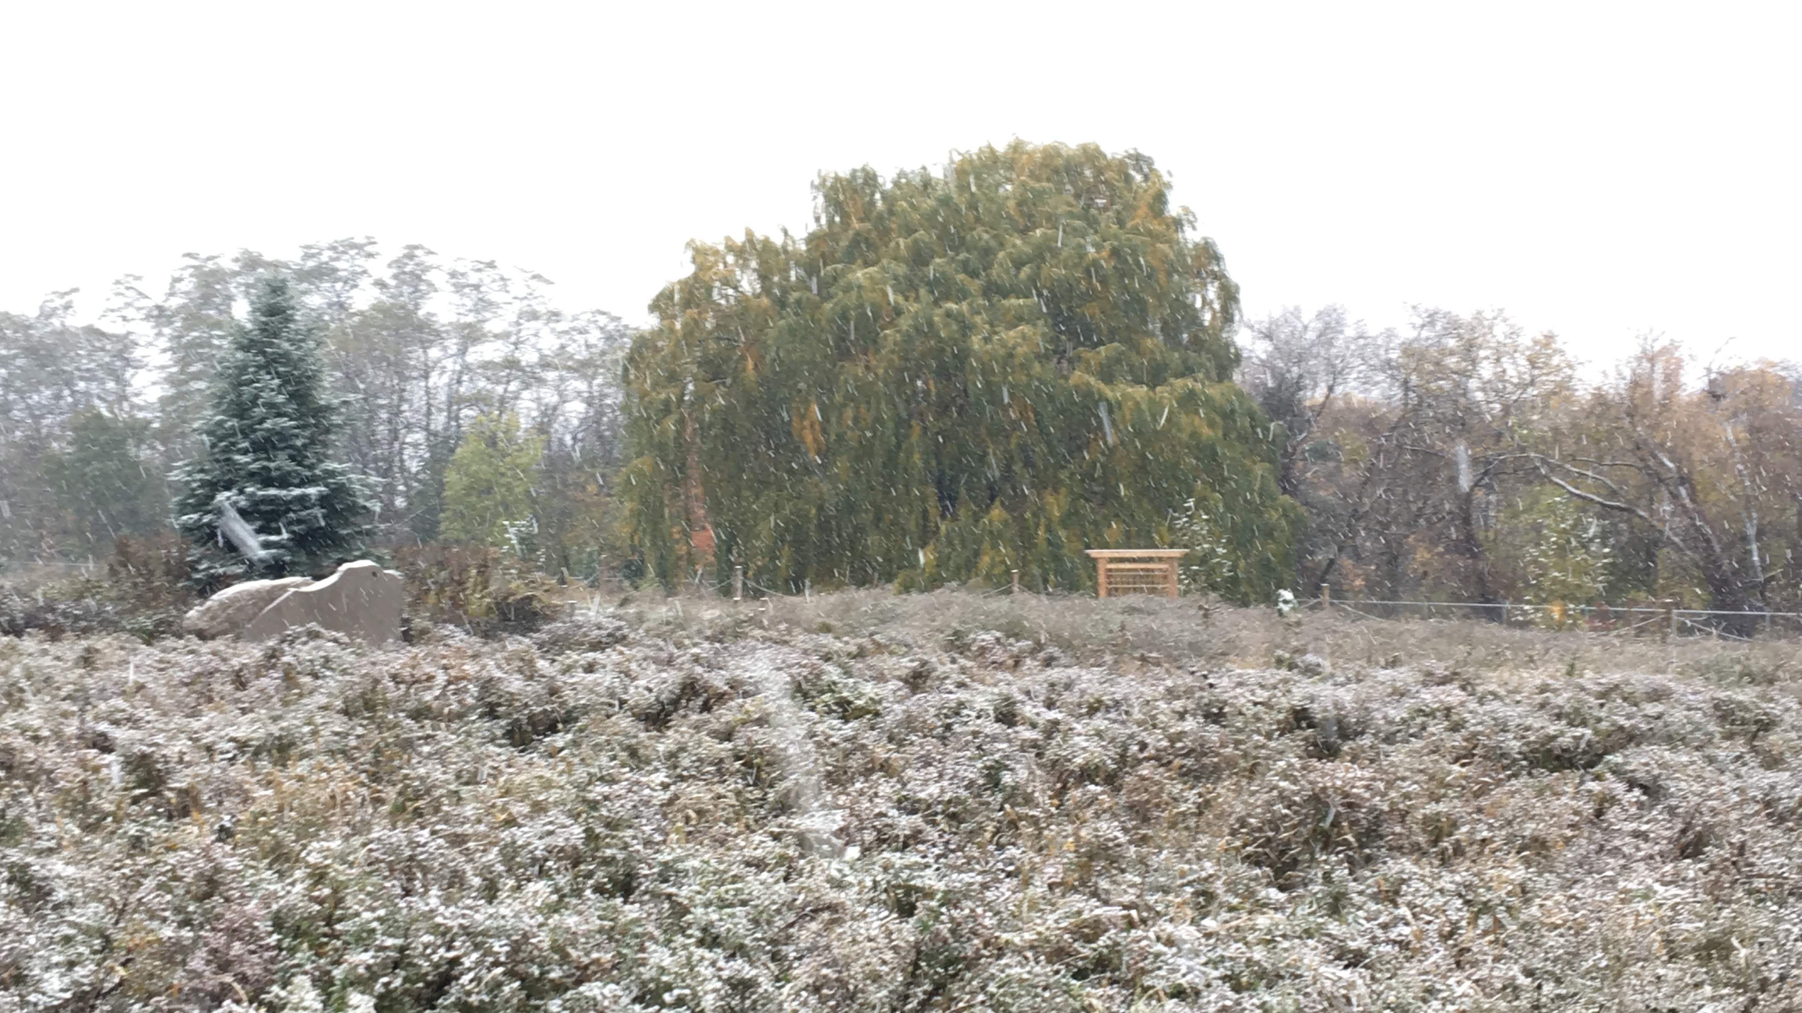

Slide 22
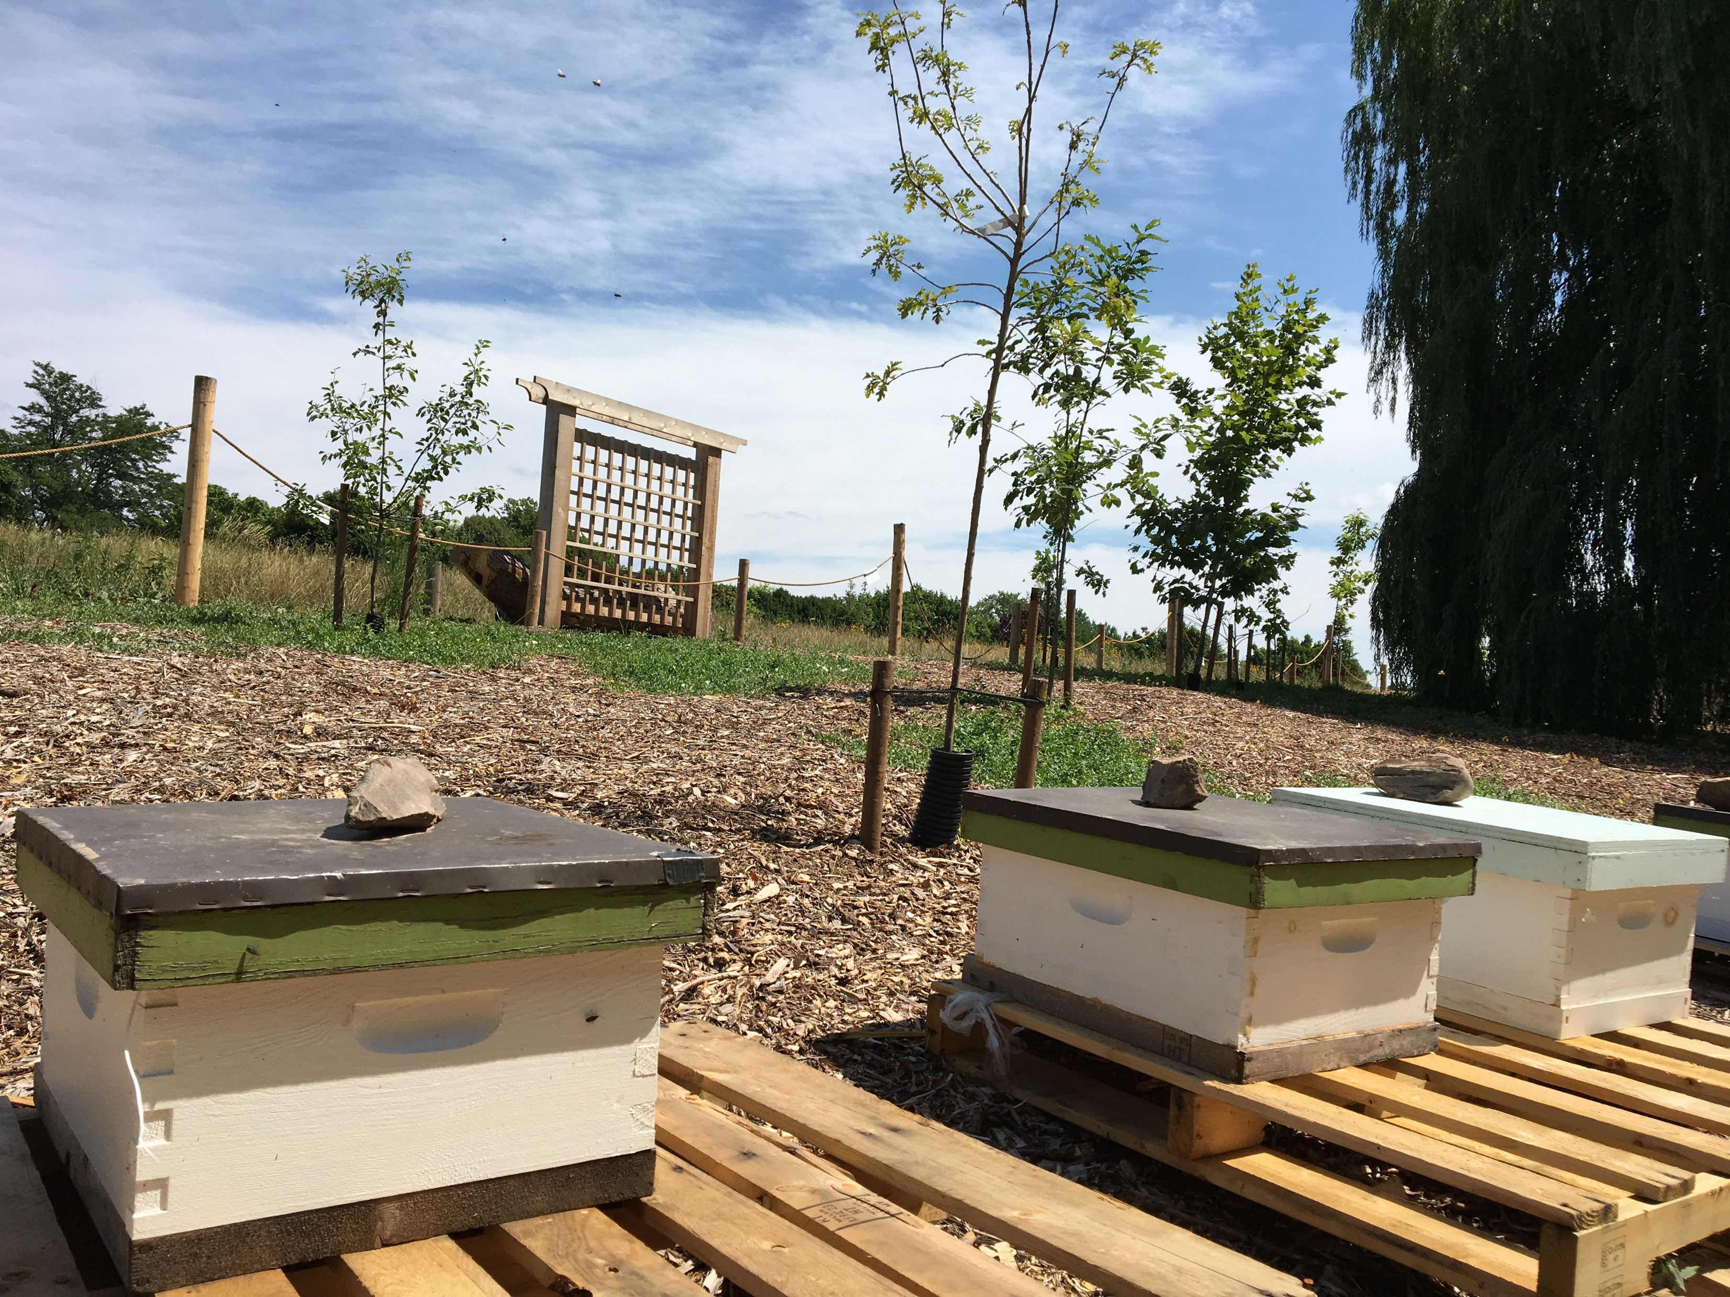
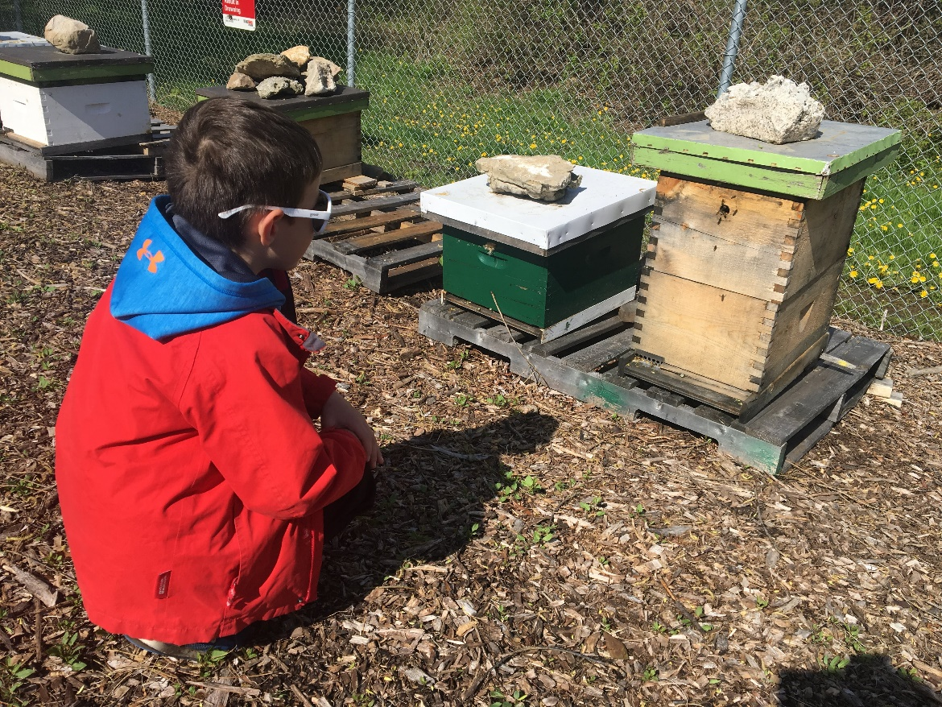

Slide 23
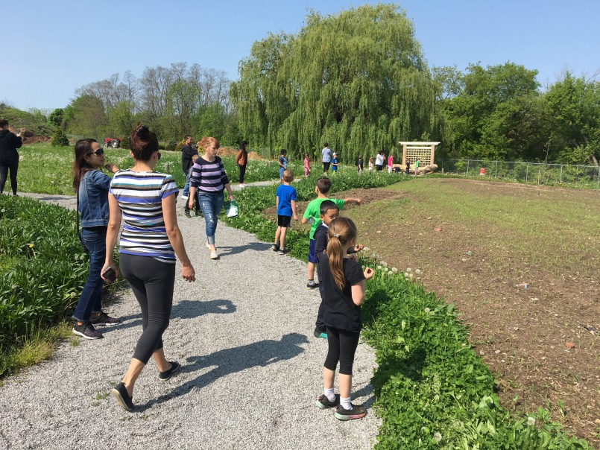
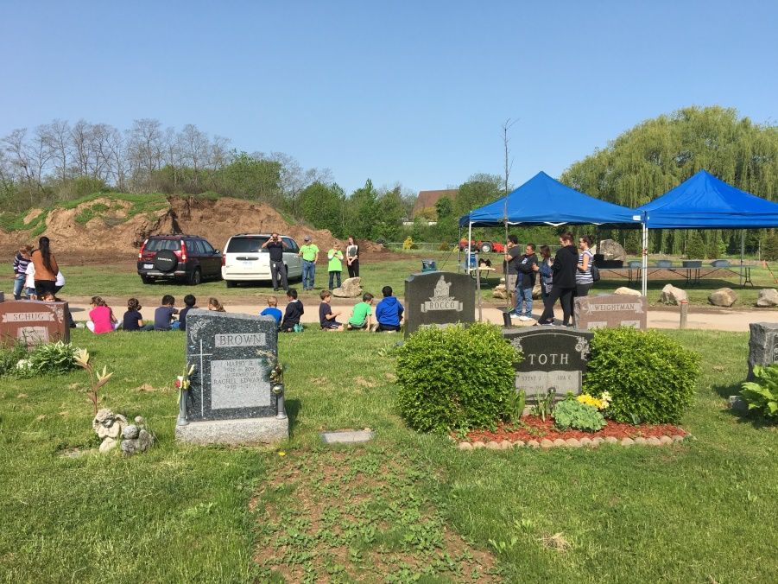
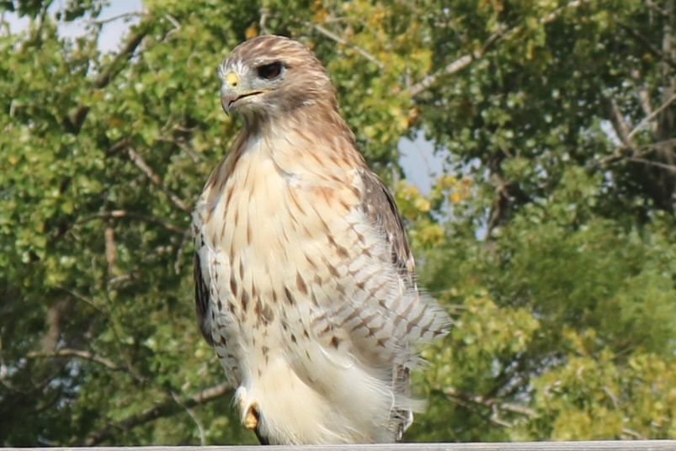
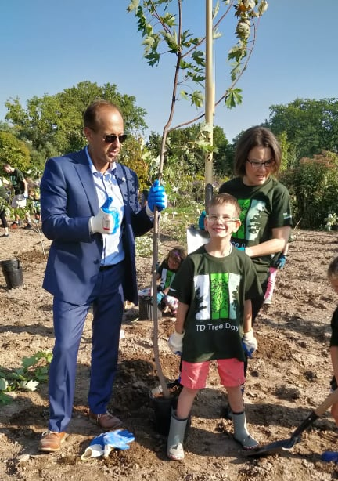
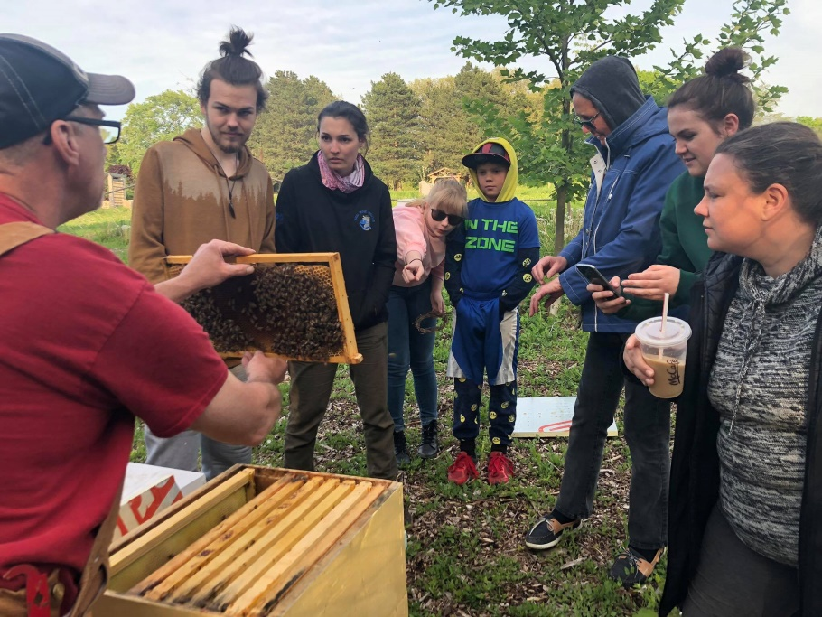
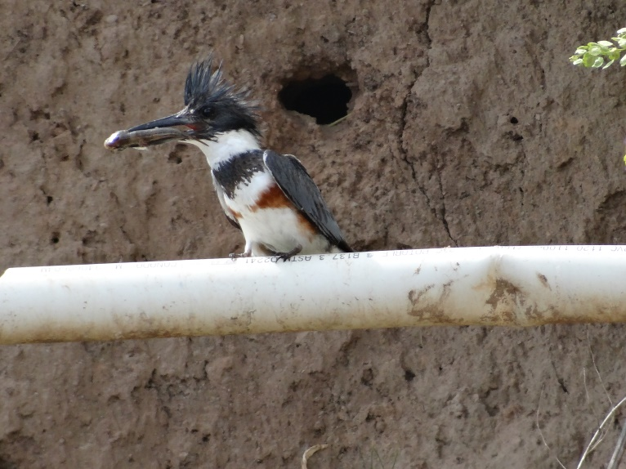
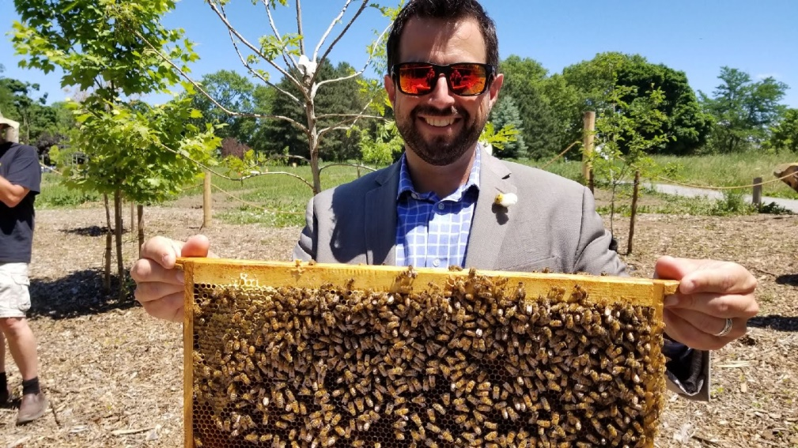

Slide 24
Existing Natural or Green Burial Grounds
Ontario
Willow’s Rest, Fairview Cemetery, Niagara Falls
Union Cemetery, Cobourg
Glenwoods Cemetery, Picton
Meadowvale Cemetery, Mississauga
Parkview Cemetery, Waterloo
Duffin Meadows, Pickering
St. James Anglican Church, Roseneath
St. John’s Public Cemetery, Jordan

Slide 25
Green and Natural Burial Resources
Green Burial Society of Canada:
http://www.greenburialcanada.ca/
Natural Burial Association:
https://naturalburialassociation.ca/
Green Burial Council (North America):
https://www.greenburialcouncil.org/
25
Notes:
Mark

Slide 26
Please fee free to connect with me directly….
Mark Richardson, Manager of Cemetery Services
City of Niagara Falls
Email: mrichardson@niagarafalls.ca
Cell Phone: 1-905-658-8541

Slide 27
Monuments are mined from quarries.
Monuments are transported and/or shipped (in some cases across country, across provinces, or even from overseas).
Upright monuments require a concrete foundation.
Sample of a Conventional Section:
Approximately 1 acre Section of 500 lots (single graves) – each with a monument (34x12 base)
Foundation = 34” x 12” x 4’ (11.33 cubic feet of concrete)
11.33 x 500 = 5,665 cubic feet of concrete (approximately 425 tons of concrete).
Ecological Impact:
Monuments & Foundations

Slide 28
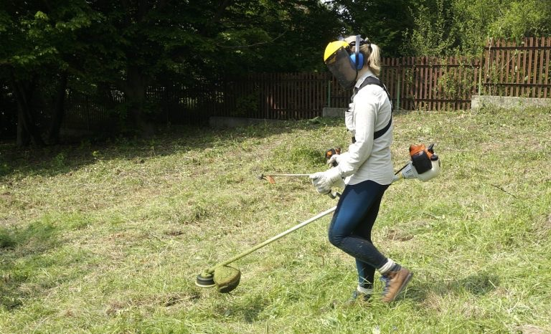
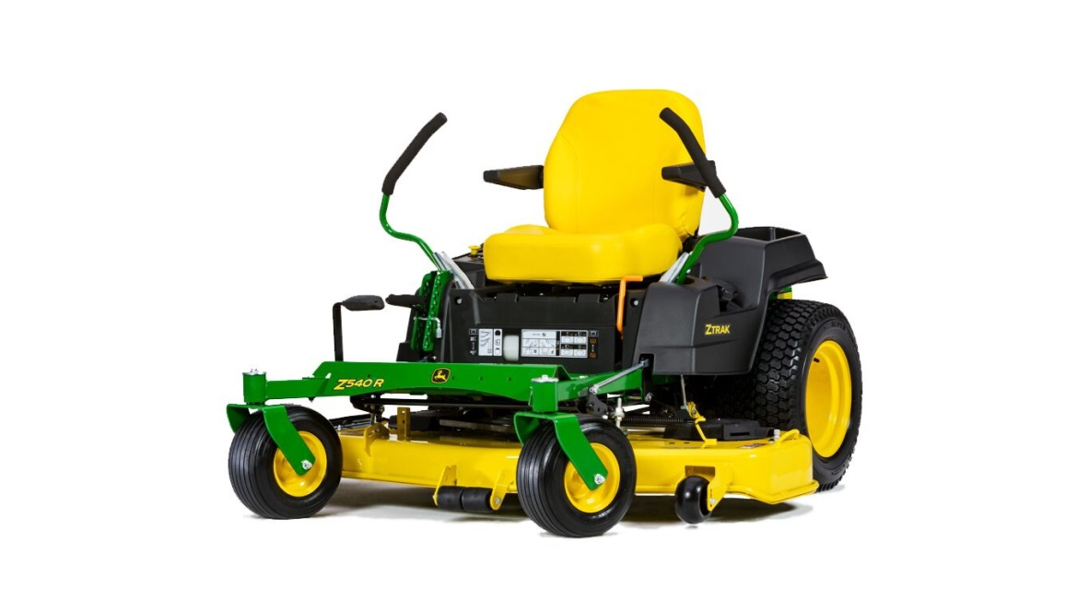
Ecological Impact:
Regular Maintenance

